Slide 1
BUS MANAGEMENT SYSTEM
Backend:
  Server and Database Interaction
  Technologies: Python
Database:
  Stores data for buses, routes, schedules, passengers, and bookings
  Technologies: MySQL
Project Objective:
Develop a functional, user-friendly Bus Management System to automate ticket booking, manage schedules, and improve operational efficiency.

Slide 2
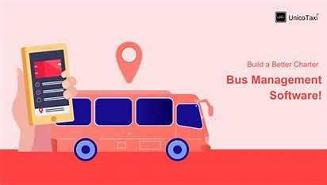
Key Modules:
User Module (Passenger):
  Passenger Registrat`ion & Login
  View Available Routes & Bus Schedules
  Book Tickets & Check Ticket Status
Admin Module (Staff):
  Manage Bus Schedules & Routes
  Add/Remove Buses
  View Passenger Bookings
Booking System:
  Bus Seat Availability
  Confirmation & Cancellation of Tickets
Payment Integration:
  Payment Gateway for online ticket purchase

